Slide 1
Multilevel-feedback queue scheduler
CCCs operating system project

Slide 2
Team members
01
02
Abdullah Turki
ID: 2140099
Samer Najmuldeen
ID: 2140123

Slide 3
Task table
Abdullah | The project was written collaboratively. This includes: Sharing ideas and suggestions As well as writing the code And presentation
Samer | Jupiter is a gas giant and the biggest planet

Slide 4
Table of contents
01
02
03
04
Project code
output
Features and capabilities
User manual

Slide 5
output of the code
Show how the project works when some vlues are entered

Slide 6
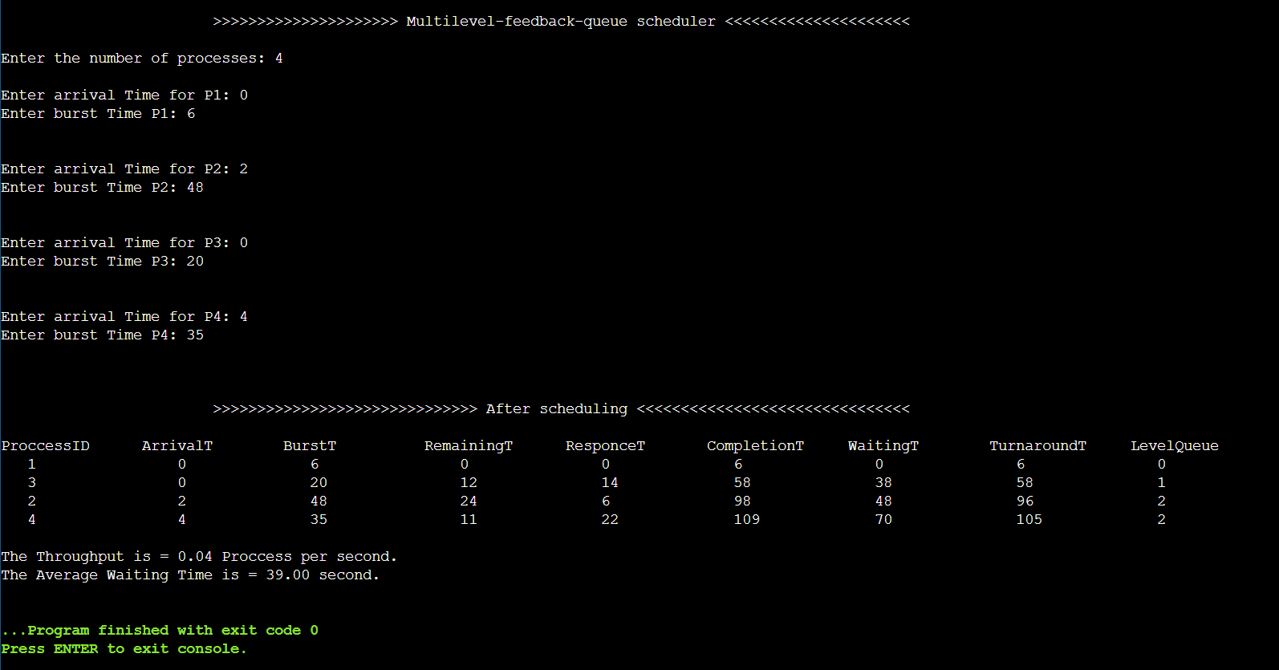

Slide 7
Features and capabilities

Slide 8
Features and capabilities
You can use multilevel queue scheduling to apply different scheduling methods to distinct processes. It will have low overhead in terms of scheduling.
Allows the user to enter an infinite number of processes
Shows the throughput
Calculate the response time, completion time, turnaround time
And waiting time
Shows the average waiting time

Slide 9
What do we offer?
1%
user effort
The user only need to enter the processes
99%
Compiler effort
All calculations are calculated, in addition to calculating the average W.T, R.T, C.T, throughput

Slide 10
User manual

Slide 11
how to use?
Set arrival, burst
number of processes
Enter the number of processes you want
Set the arrival&burst time for each process
wait
congrats
Just wait a moment, and the scheduler will do everything!!
Your processes are scheduled now

